Slide 1

Patient Education for
Outpatient
Joint Replacement Surgery
Presented by
Mary Sanders, RN, BSN
Dan D’Andrea, PT, MSPT
November 2023
Notes:
Welcome and thank you for choosing Orlando Health Jewett Orthopedic Institute for your upcoming joint replacement.

Slide 2

Notes:
Orlando Health’s mission is to improve the health and quality of life of the individuals and communities we serve.

Slide 3
Notes:
This presentation demonstrates the 6 strategic imperatives of the Orlando Health Mission.

Slide 4

Objectives of Today's Program:
To learn what you can do to prepare for your surgery at Orlando Health – Jewett Orthopedic Surgery Center
To understand the role you play in your recovery
Prepare your home
Prepare your body
Prepare your mind
SUCCESS
Notes:
Information from this presentation will help your properly prepare for your upcoming surgery. You have a great opportunity prior to surgery to prepare your home, tune up your body, and educate your brain.

Slide 5
Disclaimer
This class is to help you prepare for your Joint Replacement Surgery. It is not to replace information given by your surgeon. Your healthcare team may adjust some of the recommendations based on your personal needs. Be sure to contact your surgeon if you have questions regarding your surgery.
Notes:
The purpose of this class is to help you prepare for your Joint Replacement Surgery. It is not to replace information given by your surgeon. Your healthcare team may adjust some of the recommendations based on your personal needs. Be sure to contact your surgeon if you have questions regarding your surgery.

Slide 6
Preparing for Surgery
Notes:
Part 1 - preparing for your surgery.

Slide 7
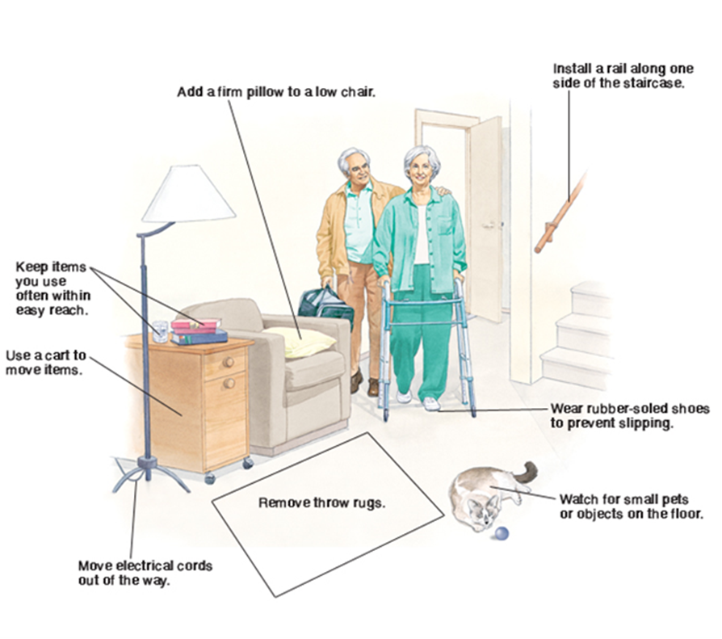
Prepare Your Home
© 2000-2008 The StayWell Company, 780 Township Line Road, Yardley, PA 19067. All rights reserved. This information is not intended as a substitute for professional medical care. Always follow your healthcare professional's instructions
Notes:
Prior to surgery, you should survey your home environment.
Clear tripping hazards such as: throw rugs and electrical cords from your pathways.
Choose a chair, preferably one with armrests, which is comfortable and easy to get in and out of.
You may stack seat cushions, firm pillows or blankets on low seated furniture to provide an elevated seat.
Place a small table next to your chair so you can easily reach the items you may need such as a phone and remote control.
Ask family or friends to move any furniture that would prevent you from comfortably moving around with your walker.
Finally, think about how you will be entering your home. Do you have to climb steps? Is there a handrail for you to use for support? If not, you may to install one.

Slide 8
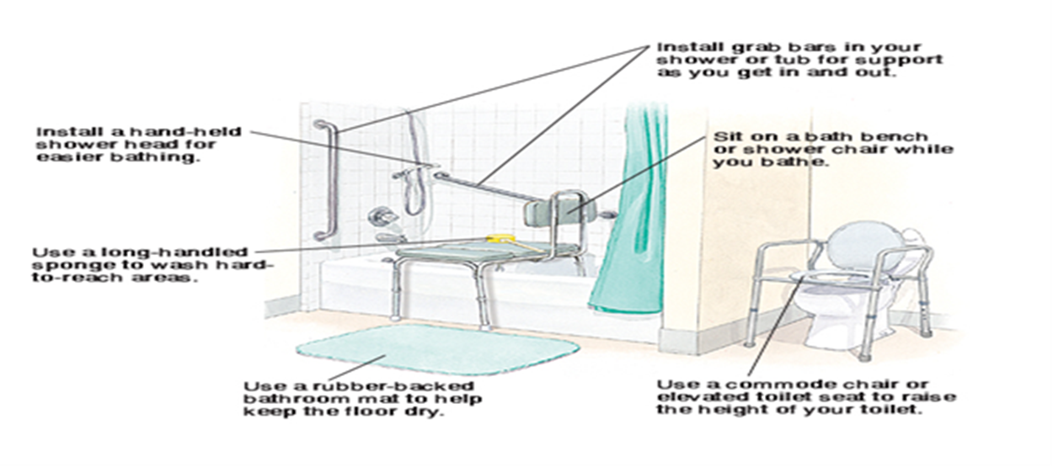
Prepare Your Home
© 2000-2008 The StayWell Company, 780 Township Line Road, Yardley, PA 19067. All rights reserved. This information is not intended as a substitute for professional medical care. Always follow your healthcare professional's instructions.
Notes:
Use a rubber backed bath mat to prevent a slip and fall
If you do not have grab bars or a hand held shower head consider installing them
A bath bench and commode chair are helpful when showering and using the commode.
A long handled sponge can make those hard to reach areas (lower legs/feet) easier to wash.

Slide 9
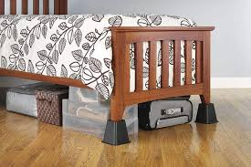
Prepare Your Home
Prepare meals ahead of time
Clean your home & prepare laundry
Make things easy to reach
Consider the height of your bed
        If your bed is too high, remove the frame or feet, if possible
        If your bed is too low, add bed risers/blocks
Consider re-location of your bedroom to the first floor.
Notes:
It may be helpful to prepare meals that you can freeze and easily prepare after surgery.
Put often used items on an easy-to-reach shelf or surface that is waist-height or above.
A bed that is too high or too low will be hard to get in or out of after surgery.
Bed risers made of wood or a heavy duty plastic can be used to elevate a bed. They are placed under bed posts and can be found at home improvement stores.
If you live in a two story house, you may want to move a bed and any essential items to the first floor

Slide 10
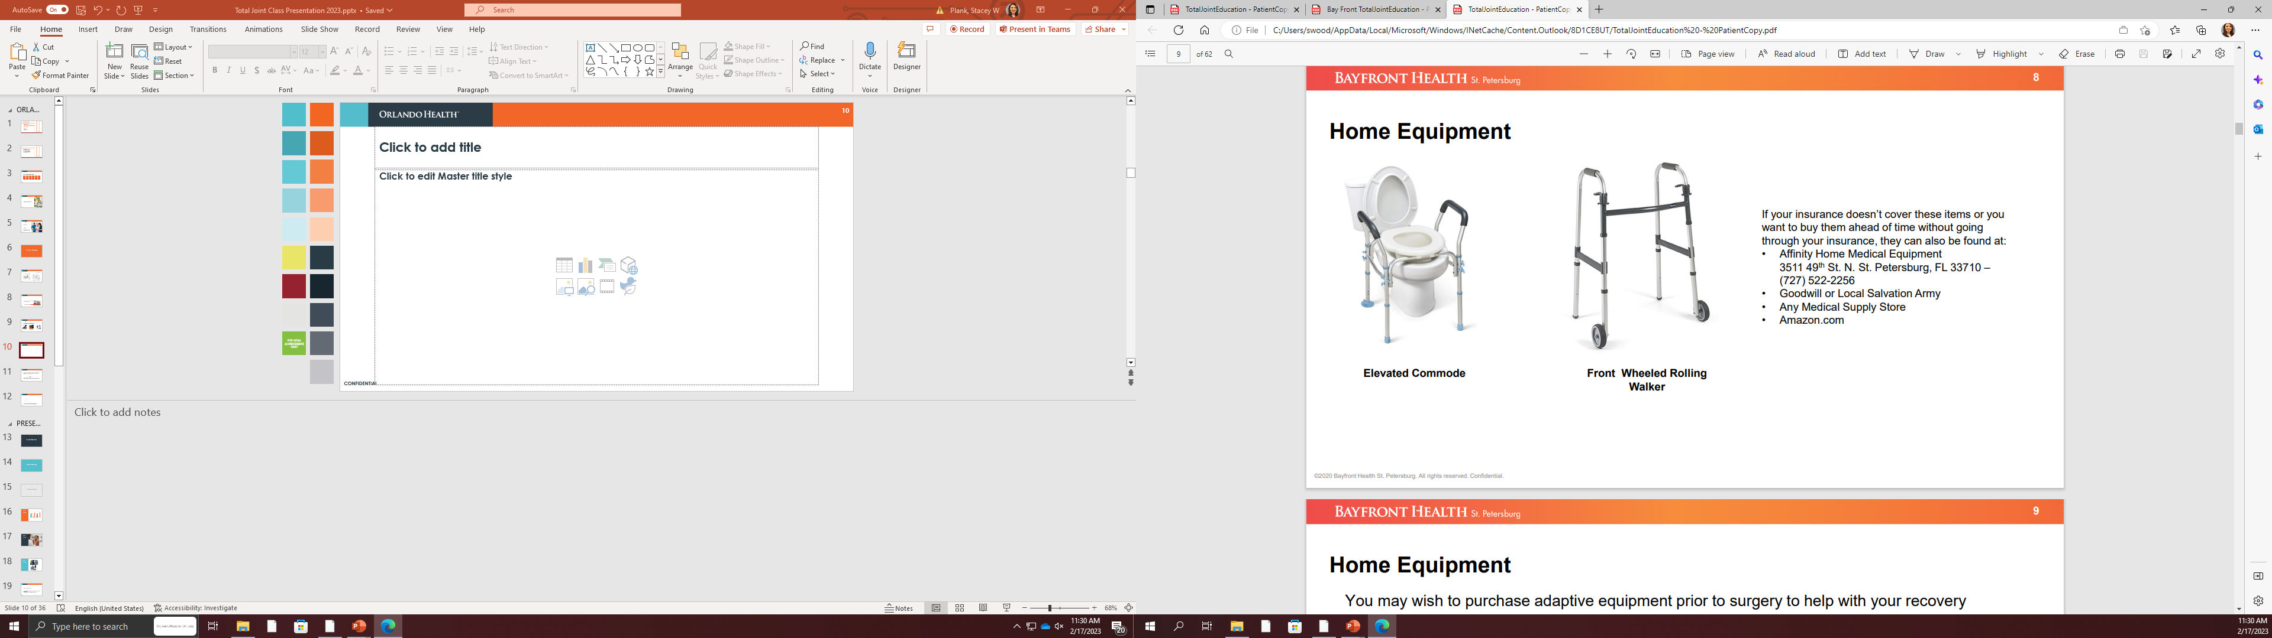
Home Equipment
If your insurance doesn’t cover these items or you want to buy them ahead of time without going through your insurance, they may be found at:
Any Medical Supply Store
Your local pharmacy
Amazon.com
Goodwill or Salvation Army
Notes:
An elevated commode is recommended for anyone having a lower extremity joint replacement. If you are having a joint replacement for your hip knee or ankle, a walker is required. Please note that your walker should be a front wheeled walker as shown above. A walker with 4 wheels called a rollator is not allowed.

Slide 11
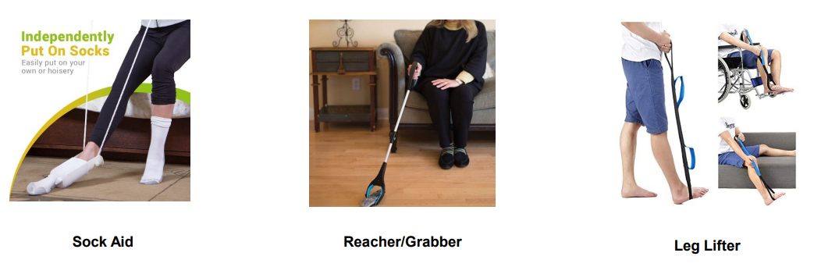
Gather Home Equipment in Advance
You may wish to purchase adaptive equipment prior to surgery to help with your recovery
Items can be found on Amazon or any medical supply store.
Notes:
Adaptive equipment such as sock aids, reacher/grabber, and leg lifter can be helpful and provide independence during your recovery.
A sock aid is an assistive device that allows you to put on your socks more easily despite pain and physical limitations.
A Reacher or Grabber is a handheld tool used to increase the range of a person's reach when grabbing objects. It can pick items up off the ground and assist you with getting dressed
A Leg lifter is designed to aid patients in getting in and out of bed, by offering additional support in lifting one, or both, of their legs.
These items are not covered by insurances but can be purchased at your local medical supply storm or online.
You may wish to purchase adaptive equipment prior to surgery to help with your recovery
Items can be found at your local medical supply store or on Amazon.com.

Slide 12
Caregiver Selection
What is the purpose of your coach/caregiver?
Have someone stay with you 24 hours per day for the first 3-7 days after surgery.
Provide assistance, support, comfort, and motivation while in the hospital and after discharge
Participate in therapy sessions and day-to-day activities
Have someone drive you to your follow up appointments.
Assist with recovery exercises, dressing changes (if applicable), and household chores (cooking, laundry, cleaning, grocery shopping, yard work, pet care, etc..)
Notes:
You will need to have someone stay with you 24 hours/day for the first 3-7 days after surgery.
Depending on your surgeon, you will either have Home Health services or attend outpatient P.T.
Therefore, you will need a friend or family member to drive you to these appointments.

Slide 13
Preadmission Process
Begins about 3-4 weeks before surgery
Lab work, tests (chest –ray, ECG, etc.)
Medical history and medications will be reviewed
  Medications that thin your blood (Aspirin, Aleve, Advil, Eliquis, Xarelto, Motrin, etc.) will typically need to be stopped before surgery. This is also true for diet pills, vitamins, and herbal supplements such as turmeric, fish/krill oil, ginkgo, ginseng, kava, and St. John’s Wort.
  We will review and discuss your medications and let you know what is safe to continue to take and what to stop taking leading up to your surgery.
Notes:
Bring your ID and insurance card to all your appointments.
There are multiple tests (such as EKG, Lab work, MRSA nasal swab, and either Cardiac or Medical Clearance) needed for your surgery.
These will be ordered by your medical provider or surgeon.
You will need to stop blood thinning medications and supplements as directed by your surgeon’s office.
Typically, this is 7 to 14 days before your surgery.
Discuss NPO status as this may vary per facility

Slide 14
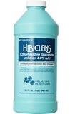
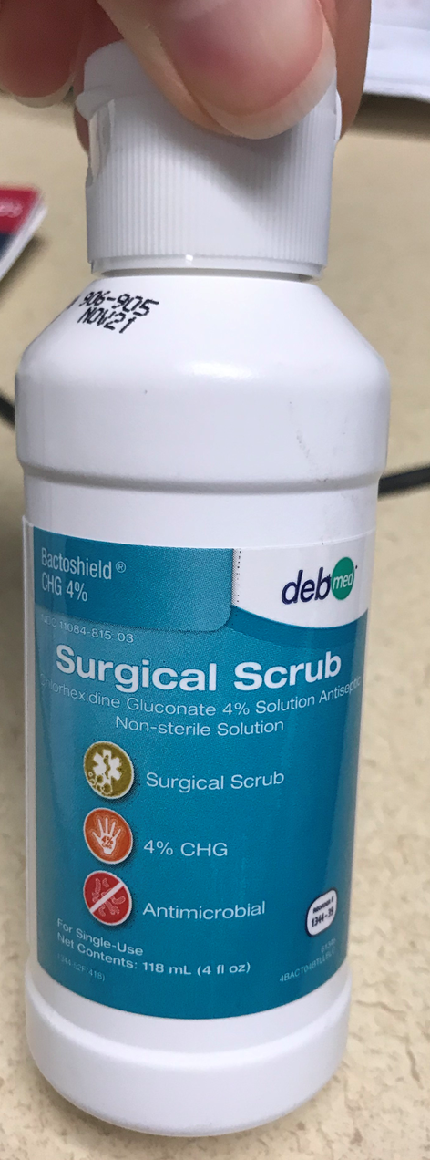
Pre-operative showers
You will be directed on how to use CHG (Chlorhexidine) soap
Studies show that repeated use of antibacterial soap enhances the residual antimicrobial effects, and this results in progressive reductions in bacterial counts on skin
Apply a clean set of sheets after showering and again before returning home, also put on clean pajamas
DO NOT:
  use on your face, hair genital area, or any open wounds
  shave the operative leg with a bladed razor (electric razor is ok). Straight edge razors may leave tiny cuts in the skin that can increase risk your risk for infection
  sleep with pets beginning 3 days before surgery and for 2 weeks after surgery
  use bleach to wash washcloth/towel after CHG soap because it will stain
Notes:
Our skin is the first line of defense against infection.
It naturally has germs or bacteria on it.
To cut down on the chance of infection, you will begin using chlorhexide soap several days prior to surgery.
Your will receive specific instructions on how and when to use this soap.
It can be purchased at your local pharmacy and is found where First Aid supplied are located.
You can also find it online at Amazon.
You will need two 8 ounce bottles.

Slide 15

Begin with a healthy diet
Good nutrition is essential to a good outcome. Begin today eating a well-balanced diet before and after surgery.
A healthy, well-balanced diet includes:
  High quality, lean proteins, fresh fruits and vegetables, and whole grains (high fiber breads and cereal products)
Increase protein intake to help with wound healing
  Consume at least 1 gm of protein per 2 pounds of body weight, unless you doctor has told you otherwise.
  Eggs, nut butters, beans, meat (poultry and/or fish), tofu, and dairy products are good protein sources.
Notes:
Diet and nutrition is very important to the healing process.
Be sure to get adequate amounts of protein for wound healing.
The food pyramid is included here to help you with food choices.
Keep in mind to eat healthy and avoid food high in sodium.
Eating fruits and vegetables daily will help prevent constipation caused by anesthesia and pain medications used after surgery.
Discuss NPO status night before surgery

Slide 16

Hydration is very important
Stay well-hydrated before and after surgery by drinking at least 8-10 glasses of non-caffeinated fluid (such as water) daily, unless your doctor has told you otherwise.
Why?
  Patients that are well hydrated before surgery…..
        Have veins that are easier to find for your IV site
        Have less nausea and vomiting after anesthesia
        Have more stable vital signs during anesthesia
        Heal faster and feel better
Notes:
It is important to stay well hydrated prior to surgery.
The day before surgery, please limit your caffeine intake.
Refrain from alcohol for 48 hours prior to surgery.
Water is essential to our bodies because it has many functions:
It Helps thin the blood and move nutrients throughout the body
It Transport waste from cells and remove toxins from body
It Helps eliminate anesthesia
It Helps prevent constipation
It Regulates temperature

Slide 17

Smoking and Surgery
Studies have shown that smoking:
Reduces blood supply to bones, muscles, joints and other tissues in the body.
Slows bone healing, the risk of bone not healing is almost 4 times greater among smokers than nonsmokers.
Increases the risk of surgical site infections—smokers' risk of infection are more than double those of nonsmokers.
Increases risk of respiratory complications after surgery prolonging hospital stay.
Increases risk of developing blood clots and elevating blood pressure after surgery.
You must STOP smoking at least 4 weeks prior to your surgery.
Notes:
Smoking interferes w/blood circulation by constricting blood vessels that carry oxygen and nutrients throughout the body.
When these vessels are constricted, it prevents optimal blood flow to the affected area slowing down the healing process and increases the chance of infection.
You must STOP smoking at least 4 weeks prior to surgery.

Slide 18
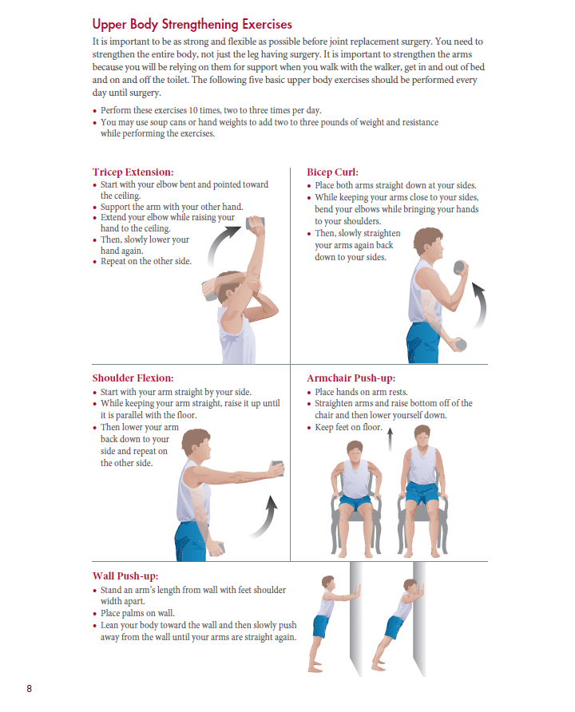
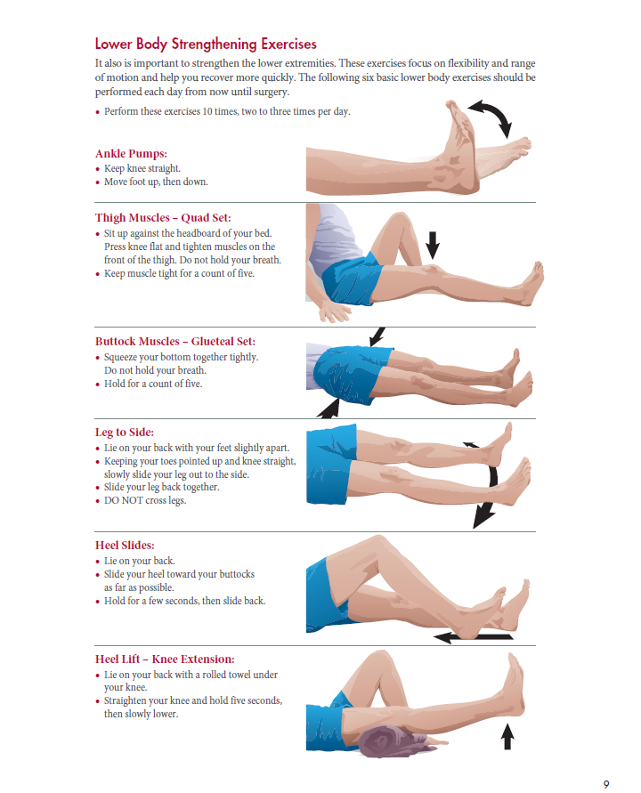

Preoperative Exercises
Notes:
Committing to an Exercise Program before surgery has many benefits.
Studies show that patients who participate in regular exercise prior to surgery have more successful outcomes than those who don’t exercise.
Take the opportunity before surgery to form a good exercise habit and improve your strength, range of motion and overall health.
If you need individualized help, pre-operative programs called “PreHab” are available.
Contact your physical or occupational therapist for more information on what your can do to prepare for surgery.

Slide 19
Day of Surgery
Notes:
Part 2 – What to expect and what to bring the day of your surgery….

Slide 20
Day of Surgery Day
Take a final CHG shower
NO lotions, powders, colognes/perfumes, or deodorants, and remove all nail polish and/or acrylic/gel fingernails if directed to do so
Take approved medications with a sip of water
Bring photo ID, insurance card, copy of living will, and credit card/money if you will be filling your prescriptions to discharge
Arrive on time at the location provided to you by preadmission or your surgeons office
Upon arrival you will be checked in and a nurse will bring you and your caregiver to the preoperative area where you will start to prepare for surgery.
  Your caregiver will be directed to a waiting area and will receive updates as you wish. Please make your preferences known
Notes:
On the day of surgery..
Please remember to take you last chlorhexide shower.
If applicable, your may take approved medication with a small sip of water.
The surgery center has a Pharmacy that can provide any new, postoperative medications ordered by your surgeon. They can be delivered to you in the PACU after surgery.
Your caregiver will be able to be with you in pre-op and later in the recovery room.
Please also remember to bring your rolling walker and your 3 pair of Depends undergarment with you when you report to the pre-op area.
Discuss:
Pharmacy process (meds-to-bed)
Visitation policy (hours & number of visitors allowed)
Valet/parking options
Lodging options
Does pt need to bring in walker

Slide 21
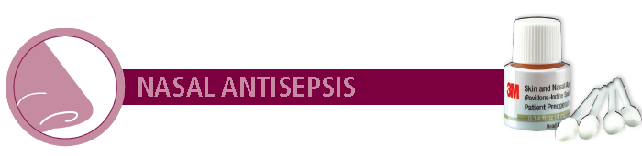
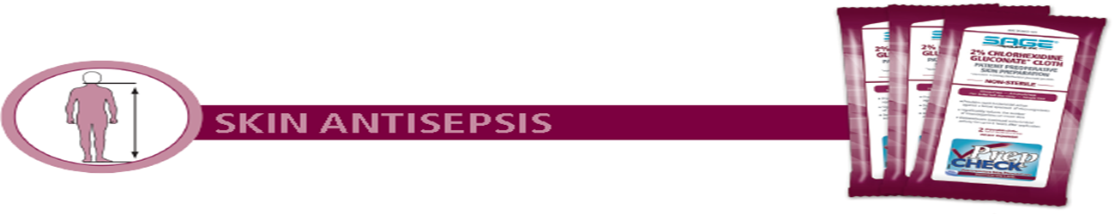
The Preoperative Process
Preop staff will:
  Review health history and medications
  Instruct you with nasal prep and skin cleansing cloths
  Assist you in surgical attire
  Place IV (intravenous) lines
Use a tissue to clean inside of both nostrils including inside tip of nostril. Using swabs provided cleanse inside of nose as indicated.
Note: Do NOT blow nose. If solution drips out of nose, it can be lightly dabbed with a tissue.
Gently wipe for coverage using 1cloth per indicated area. DO NOT scrub.
Notes:
When you arrive to the Preoperative Area, you will empty your bladder and wash your hands.
You will be given an Iodine Nasal prep and Skin Cleansing cloths.
The iodine swabs helps kill microbes and provides up to 24 hours of protection
You will be given 6 cleansing cloths to wipe down with prior to applying your gown.
It should take no more than 5 minutes to wipe down and donn your gown.
You will be given instructions from you nurse on when to put your Depends undergarment on.
Preop process (consents, site marking, etc.)

Slide 22
Anesthesia Type
This decision is based on the best choice for you once a conversation with your anesthesiologist and surgeon have occurred. You may have:
General Anesthesia: Inhaled anesthesia gas with intravenous sedation medications and intubation. You may be sleepy but should be able to feel and move legs when you wake up
AND/OR
Spinal Anesthesia: Numbing medication injected into your back (in-between your vertebrae) to numb you from the waist down, along with intravenous sedation medications. You will most likely be more alert/wake up quicker after surgery but may not be able to feel or move your legs for a couple of hours after surgery.
AND/OR
Peripheral Nerve Block: Numbing medication injected near the joint which is being replaced.
Notes:
You will meet your Anesthesiologist in the pre-op area prior to surgery to discuss your anesthesia options.
Patients having hip or knee replacements typically receive 2 types of anesthesia - General Anesthesia and Spinal Anesthesia, commonly called a spinal block.
A peripheral nerve block may also be performed to help control post operative pain.
Patients having shoulder replacement typically receive General Anesthesia but are also supported by a peripheral nerve block.

Slide 23
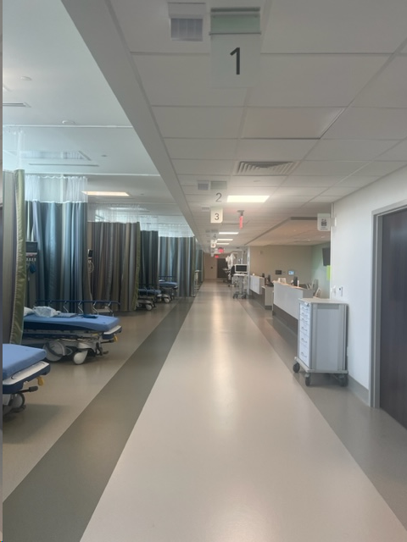
In the Recovery Room
After surgery you will wake up in the recovery room
Anticipate being there for 2 –4 hours or longer if needed
You may feel cold and have a dry mouth from anesthesia
Your throat may feel sore if a breathing tube inserted in surgery
You will be given oxygen to help wake you up
Vital signs will be monitored frequently
The nurse will also monitor discomfort/pain level
Notes:
When Surgery is complete, your surgeon will contact your caregiver to let them know how the procedure went.
Your will be transferred to the Recovery room.
The Recovery room nurse will contact your caregiver and invite them back to the recovery bay to accompany you until it is time for discharge.

Slide 24
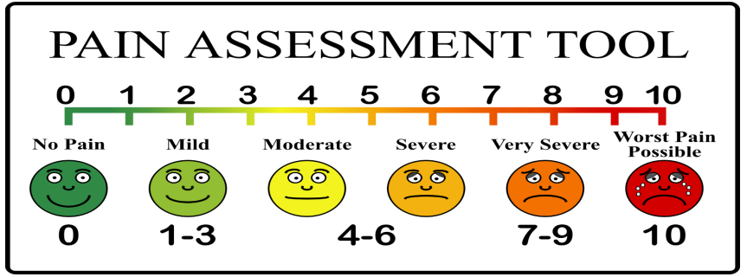
Pain Management
Orlando Health uses the 0-10 rating scale to measure pain
Your nurse will ask you for your pain goal and to rate your pain throughout your stay.
Your pain goal is a number that represents the pain level at which you will be able to tolerate while walking with assistance or conversing with family/friends.
A “3-5” is the average goal after a joint replacement.
Notes:
During your stay, you will be asked to rate your pain on a 0-10 scale.
Zero represents no pain, and 10 represents the worst possible pain.
It is not realistic to be a zero,
Pain medication will be given as needed to be “tolerable discomfort” by discharge.

Slide 25
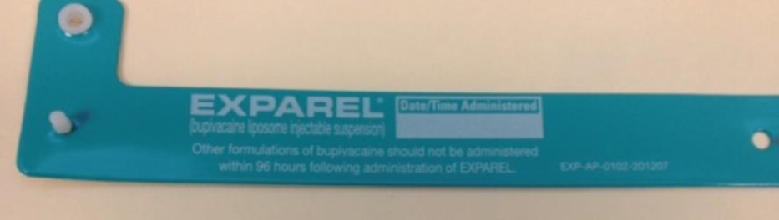
Pain Management
A variety of methods are used to help control your pain:
      IV/Oral pain medication
      Non-steroidal anti-inflammatory (NSAID) medications
      Muscle relaxers
      Cold therapy machine/ice packs
      Relaxation (i.e. Meditation, Music, Deep Breathing, etc.)
      Peripheral Nerve Block
Notes:
A variety of techniques will be used help manage your pain after surgery.
A very effective technique is called a Peripheral Nerve Block.
It is a procedure performed by the anesthesiologist just prior just prior to your surgery.
An injection of numbing medication is administered near the nerve that affects the joint you are having surgery on.
Note that a routine nerve block may last 12-24 hours.
The anesthesiologist may include a medication to the injection called “Exparel”.
A nerve block with Exparel may last up to 72 hours.
If you have been given Exparel, you will be given a teal wristband as shown above.
It will need to be worn around your wrist for the first 96 hours after surgery.
Its purpose is to alert other healthcare providers not to give any similar medications causing toxicity.
The bracelet includes the drug’s name and lists the date and time you are allowed to remove it.
Nerve block is a procedure where the anesthesiologist injects a numbing medication to the nerve that effects the joint your having surgery on
May last 12-24 hrs
Exparel is a numbing medication that is injected into the soft tissue where the incision is made and can last up to 3 days (72 hrs)
If given you may notice an increase in pain 2-4 days after surgery. This pain is normal because the medication is wearing off
A teal-colored wristband will need to be worn for the first 4 days (96 hrs) after surgery, even when you are home.
The wristband was designed as an alert to other healthcare providers to not give you medications that contain Exparel for at least 4 days after your surgery
You should not be given any additional anesthetic agents (i.e. lidocaine) within 4 days to avoid the risk of immediate bolus release of Exparel, this can lead to potential adverse events.
Toxicity: Restlessness, anxiety, incoherent speech, lightheadedness, numbness and tingling of the mouth and lips, metallic taste, tinnitus, dizziness, blurred vision, tremors, twitching, depression, or drowsiness may be early warning signs of central nervous system toxicity.

Slide 26
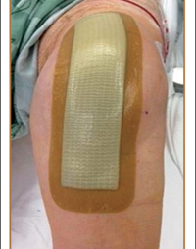
Surgical Dressing
Aquacel
Water-proof dressing that absorbs and locks in fluid and blocks out bacteria. It is left in place for 7 days post-op.
Notes:
Your surgeon will close the surgical site with either stitches, sutures, staples, or skin glue.
Your incision will then be covered by an Acquacel dressing.
The Acquacel dressing is waterproof and meant to be left in place for 7 days post-operatively.

Slide 27
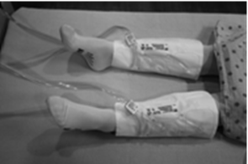
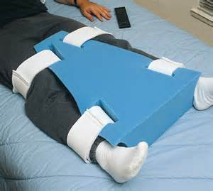
After Surgery You May Have:
Inflatable sleeves around your legs
Abduction pillow (hips)
Knee Immobilizer
Notes:
After your surgery, you may have one or more of these devices on your legs.
Venaflo devices are inflatable sleeves which have been applied to your legs to help prevent blood clots.
An abduction pillow may be used for hip replacements patients to prevent dislocation of the hip immediately after surgery.
A knee immobilizer may be used for patients who require additional knee support after surgery.

Slide 28

Meds to Bed
...fill your prescriptions here...
The Pharmacy will communicate directly with patient/family and is available for consultation
Remember, controlled substances such as opioid pain medications, require you to hand-carry the prescription to the pharmacy.
  Narcotic prescriptions cannot be phoned or faxed
Notes:
The Surgeon may utilize “meds to bed” program through Select Pharmacy when ordering your postoperative medications.
If so, these medications can be delivered to the bedside prior to discharge.

Slide 29
What you need to know after surgery
Notes:
What you need to know after surgery.

Slide 30
Physical Therapy In the Recovery Room
Practice with you on bed mobility, transfers, and walking
Review joint precautions and protection techniques
Review your post-operative exercise plan
Provide coach/caregiver training
Stair or step training, if needed
Notes:
Patients having a lower extremity joint replacement will have Physical Therapy evaluation and treatment sessions while in the Recovery Room.
Typically, this begins an hour after entering the recovering room.
The therapist will begin the rehabilitation process with mobility training with your rolling walker.
You and your caregiver will also be instructed on your home exercise routine and about any specific rules commonly known as “joint precautions”.

Slide 31
Pneumonia
How do you prevent pneumonia?
Use your incentive spirometer as instructed
Cough and deep breathing to clear lung congestion
Hand washing to prevent infection
Get enough sleep, exercise, and eat a healthy diet to keep your immune system strong
No smoking (http://tobaccofreeflorida.com/)
Vaccinations
Notes:
It is important to prevent pneumonia after surgery.
You will be given an incentive spirometer and instructions in its use.
The goal to achieve is a slow sustained breath in.
This should be done 10-15 times per hour while awake for the first several days after surgery.

Slide 32
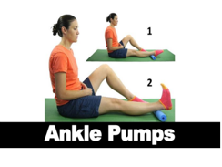
Blood clots (DVT/PE)
How do you prevent blood clots?
Blood thinners (anticoagulants)—Aspirin, Xarelto, Eliquis, or Lovenox
Sequential compression devices and/or compression stockings (TED hose)
Activity/Exercise
  Ankle pumps (pump your feet up and down)
  Walking
Signs & Symptoms of DVT or PE
  Increased pain & tenderness in your leg, often starts in the calf and may feel like cramping or soreness
  Increase swelling or warmth in leg
  Red or discolored skin on your leg
  Shortness of breath
  Sudden chest pain
  Painful breathing
  Report these symptoms to your surgeon right away!!!
Notes:
There are several ways to prevent blood clots.
Your surgeon will prescribe a blood thinner to begin AFTER surgery.
The nurse will apply compressive socks commonly called TED hose, and a Venaflo device to your lower legs.
The best and most active way to prevent blood clots after surgery is to simply walk. During the day, try to get up and walk each hour.
Early and routine ambulation after surgery helps prevent post surgical complications such as blood clots and constipation.
Ankle Pumps are a good exercise to help move blood in the calf which aids in blood clot prevention.

Slide 33
Constipation
How do you prevent constipation?
Healthy diet and hydration
Walking/Exercise will help promote bowel movement
Medications
  Stool softeners/laxatives/fiber supplements
        Colace
        Senokot
        Miralax
        Milk of Magnesia
Move your bowels when you feel the urge. Do not wait.
Daily Fiber Recommendations:
Men 50 or<: 38 grams
Men 51 or>: 30 grams
Women 50 or <: 25 grams
Women 51 or>: 21 grams
Notes:
Anesthesia, narcotics, decreased fluid intake, and lack of activity are leading causes of constipation.
Eating properly with plenty of fruits and vegetables and drinking fluids will help prevent constipation.
Other suggestions include stool softeners and laxatives such as Colace, Miralax, and Milk of Magnesia. We suggest starting one of these the day after surgery.

Slide 34


Infection Prevention
Hand hygiene--#1 way
Surgical dressing
Healthy diet
Clean home environment
  Change linen and pajamas frequently
  Be mindful of pets
  Use clean washcloths and towels on a daily basis.
Notes:
Hand washing is the best way to help prevent infection.
The best way to wash your hands is to:
wet them with water and apply soap, lather and scrub for at least 20 seconds before rinsing.
Be sure to change and clean bed linens often.

Slide 35
Dental Appointments
Dental Visits:
Pleases do NOT schedule routine dental procedures such as cleanings for a month prior to surgery and for SIX months after your Joint Replacement Surgery unless you have an urgent dental need (i.e., a broken tooth or dental abscess). You will need to pre-medicate with an antibiotic before all dental visit for TWO years after your Joint Replacement. This medicine will be ordered by your surgeon or your dentist depending on their preference.
Notes:
Your surgeon asks that you do not schedule dental cleanings within a month of your upcoming surgery.
And, not again for 6 months after surgery.
Dental Emergencies, like an abscess or broken tooth, must be handled ASAP.
Either your surgeon or dentist will prescribe an antibiotic prior to ALL dental procedures for 2 years following your joint replacement.

Slide 36
When to Call Your Surgeon
Call you surgeon if:
  Excessive pain or swelling in your leg
  Pain that is increasing or no longer controlled by pain medication
  Numbness or tingling in your leg or foot
  A change in color in your leg/foot: pale or dusky
  Chills, fever of 101 F or higher, which may be a sign of infection
  Unusual redness, heat, or drainage at the incision site
Notes:
Contact your surgeon should you experience excessive leg swelling or pain, a temperature of 101 or higher, pale or dusky appearance to the leg or foot.

Slide 37
Total Joint Precautions
After
Hip or Knee Replacement
Notes:
Hello, and hang in there. Just a few more slides to go as we finish your pre-operative education class. My name is Dan D’Andrea and I am a Physical Therapist.
Here are some final tips on precautions after hip and knee replacement surgery.

Slide 38
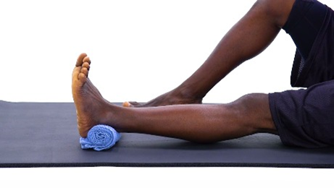

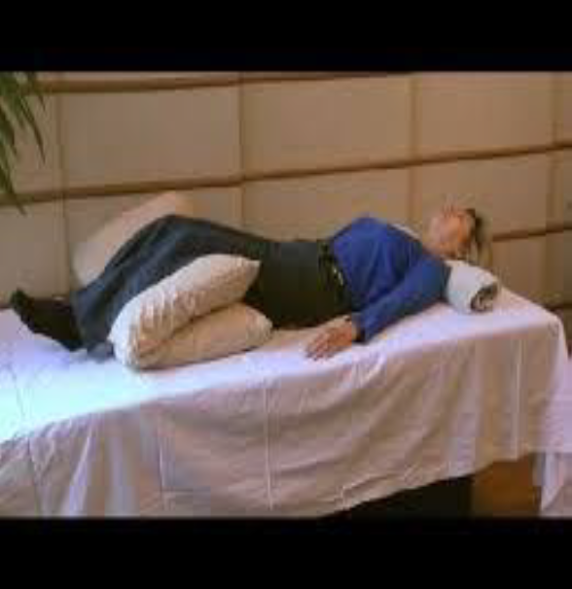

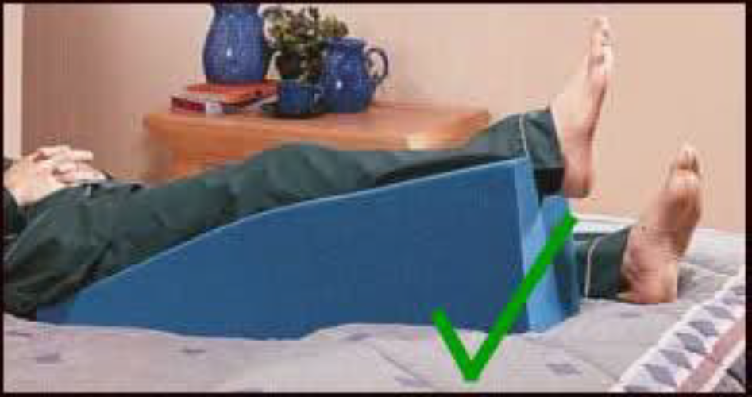
Total Knee Arthroplasty Precautions
Do not rest with a pillow or other support behind your bent knee. It can allow the knee to stiffen in the bent position.
Notes:
Following knee replacement, attaining knee extension is one the most important goals.
As shown is top right picture, the position to help promote full knee extension is when a small towel roll is placed under the ankle of the operated side.
As a precaution, do not rest with a pillow or other support behind your bent knee as It can allow the knee to stiffen in the bent position.
It common for your lower leg to become swollen To reduce the swelling in your leg and foot , elevate it for 30 minutes 2-3 times per day by using multiple pillows or a wedge pillow that maintains a straight knee.

Slide 39
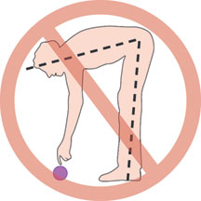
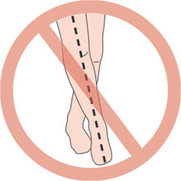
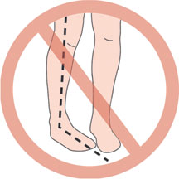
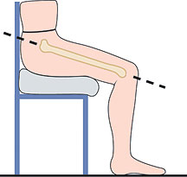
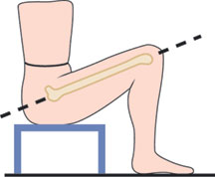
Total Hip Replacement Precautions (Lateral or Posterior Approach)
2. Adduction Precaution—Don’t cross your operated leg over your other leg. Always keep your thighs apart.
Flexion Precaution—Don’t bend forward at the
waist greater than 90 degrees.
Sitting safely—Avoid low seating positions that cause
your flex more than 90 degrees.
Don’t sit with your hips lower than your knees
3. Internal Rotation Precaution--Don’t turn your operated leg inward (pigeon toe).
Good
Bad
Notes:
After hip replacement surgery, patients have “precautions” or positions to avoid.
Precautions generally last for 6 weeks, but check with your surgeon for specific instructions.
If your hip replacement is performed with a lateral or posterior approach, there are 3 restricted positions to avoid.
1. Do not flex your hip greater than 90 degrees as in bending forward. Therefore avoid sitting on low seats.
2. Do not cross your legs. Keep a small space between your knees, especially when transferring from sit to stand, or when lying down.
3. Do not rotate your operated hip inward excessively, This means, avoid the “pigeon-toed” position while walking or turning around.

Slide 40
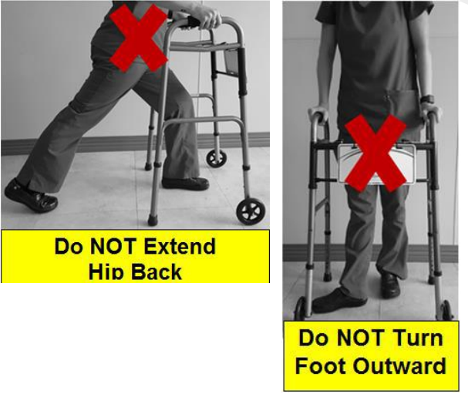
Total Hip Replacement Precautions (Anterior Approach)
Precautions
  No hip extension
  No external rotation
Note: Some surgeons may not have any precautions for anterior approach.
Notes:
Patients having hip replacement with an anterior approach will generally have 2 precautions.
No excessive hip extension, as this will place pressure on the anterior hip incision.
No excessive external rotation of the operative leg, commonly called “duck foot”.
When turning, pick up your feet to avoid pivoting on the operated leg.

Slide 41

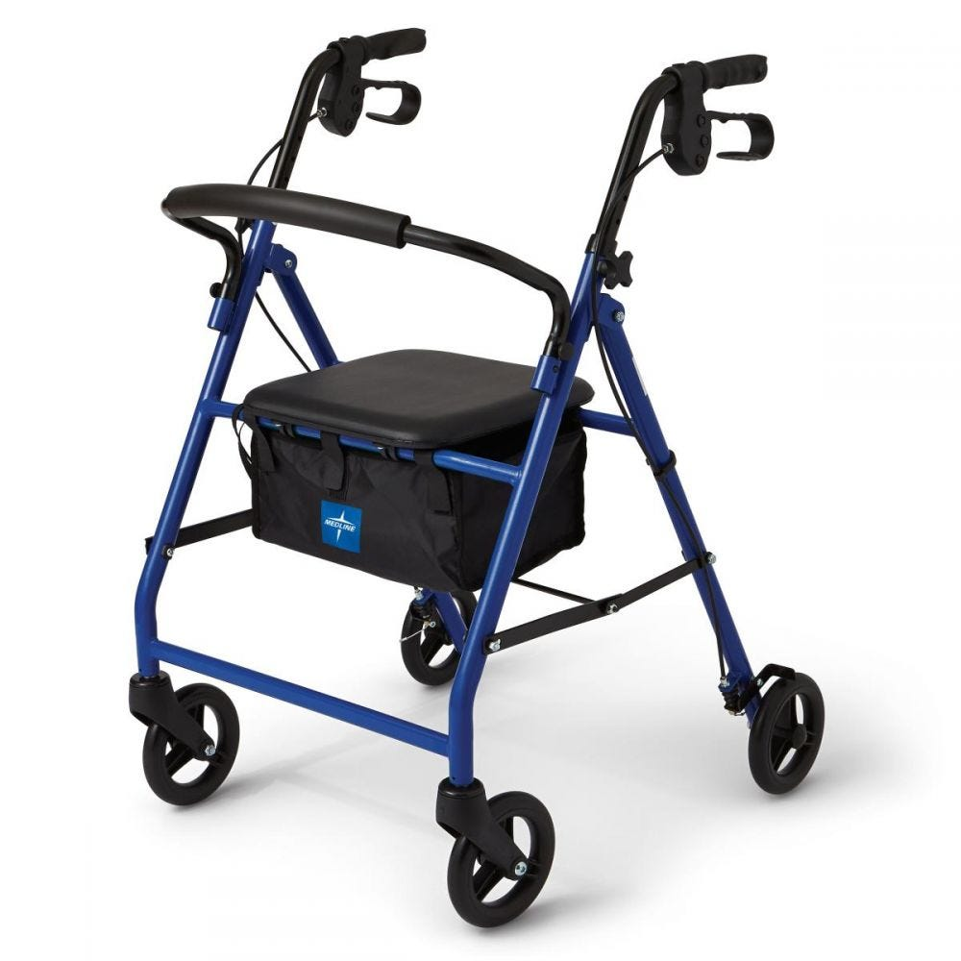
Adjusting the Walker
The height of the walker should reach the crease at your wrist when your arms are resting at your sides while standing.
Safety Tips:
Paths should be clear of cords or throw rugs as the walker may easily catch on them.
Wear comfortable shoes that have rubber soles or non-slip socks.
Notes:
Please bring your front wheeled rolling walker to the surgery center to use after surgery. Your physical therapist will make sure it is adjusted properly. The height of the walker should reach the crease at your wrist when your arms are resting at your sides while standing.
Please note that a walker with 4 wheels and a seat, commonly know as a rollator, is not recommended.

Slide 42
Questions?
Mary Sanders, BSN, RN,
Clinical Coordinator
Mary.Sanders@orlandohealth.com

Slide 43
Resources
https://health.clevelandclinic.org/foods-to-help-healing/
https://my.clevelandclinic.org/health/diseases/4059-constipation
https://www.mayoclinic.org/diseases-conditions/pneumonia/symptoms-causes/syc-20354204
https://www.webmd.com/dvt/blood-clots-after-surgery
McNally CM, Visvanathan R, Liberali S, Adams RJ. Antibiotic prophylaxis for dental treatment after prosthetic joint replacement: exploring the orthopedic surgeon's opinion. Arthroplasty Today. 2016 Mar 3;2(3):123-126. doi: 10.1016/j.artd.2015.12.003. PMID: 28326413; PMCID: PMC5045463.
Patient Care Policy and Procedure #5091, Liposomal Bupivacaine (Exparel)

