Slide 1

Preoperative Spine Class
Christopher Ingram BSN,RN-ONC

Slide 2
Understanding Your Surgery

Slide 3
Benefits of Spine Surgery
Reduces Pain
Decreases symptoms like tingling and or numbness
Improves strength
Improves quality of life by allowing you to do daily tasks and low-impact activities with greater comfort
Provides years of easier movement and greater mobility

Slide 4
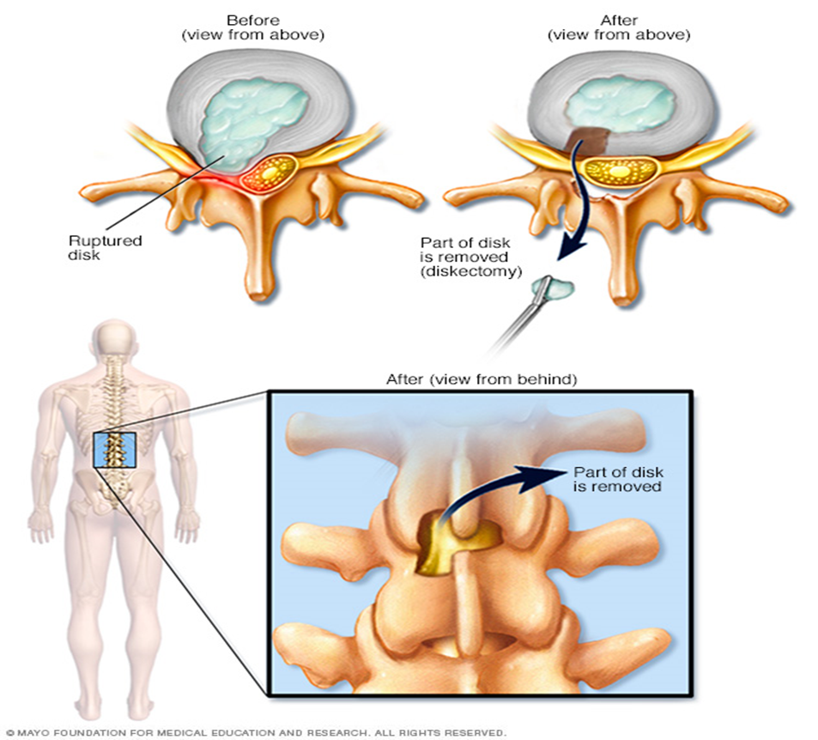
Surgery Types
Discectomy

Slide 5
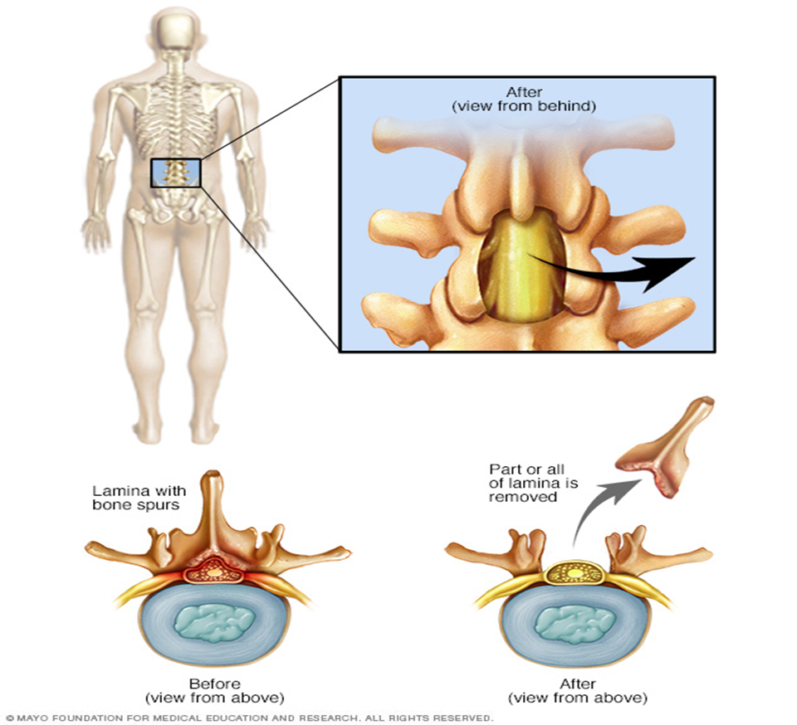
Laminectomy

Slide 6
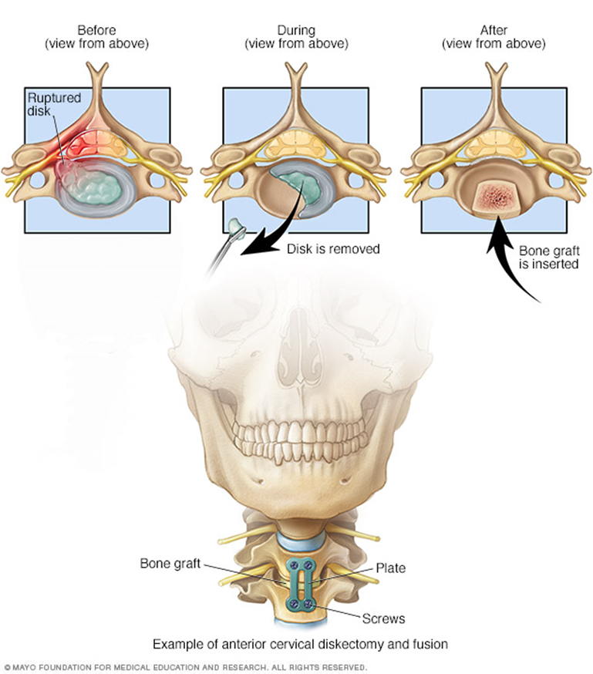
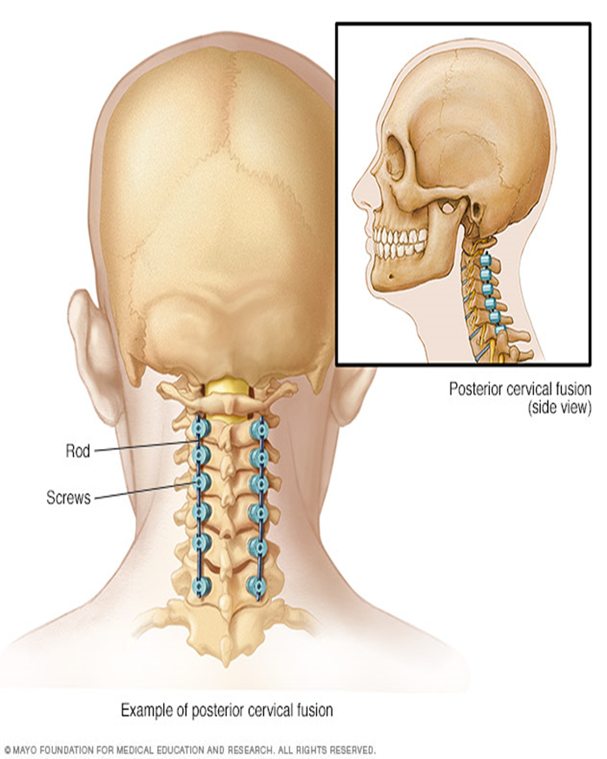
Cervical Fusions

Slide 7
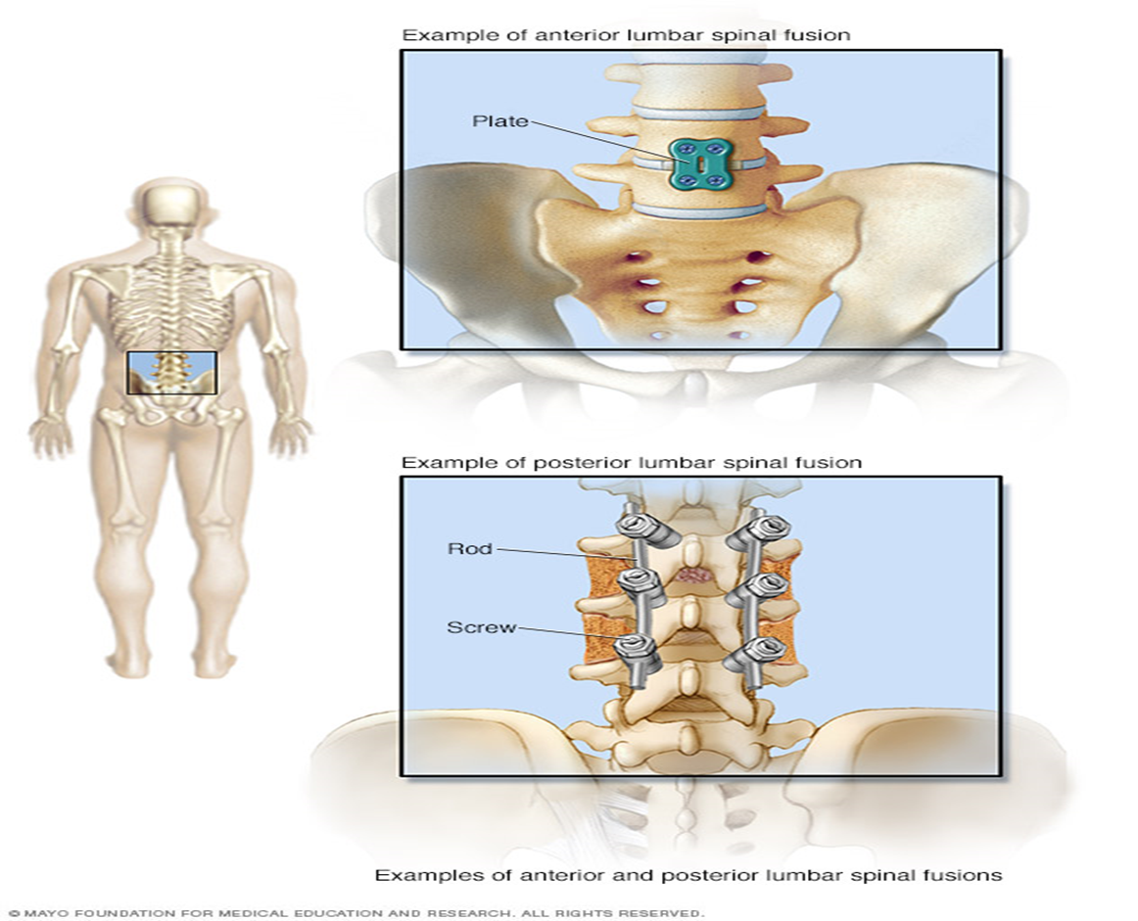
Lumbar Fusions

Slide 8
Before Surgery

Slide 9
Preparations
Arrange for a ride home, based on your estimated discharge from the hospital.
If necessary, make plans for someone to stay with you until you can get around safely.
Ask someone to help you with housework, yard work, pet care, grocery shopping, and possibly bathing if needed.
Clear any items from your walking paths, including throw rugs, and move any furniture that would prevent you from comfortably moving around. Consider safety bars and/or slip mats for your tub/shower.
If you live in a two-story house, you may want to stay primarily on the first floor for the first few weeks after surgery, our therapy team will work with you to determine your needs.

Slide 10
Preparations - continued
We recommend that someone help you move your essential cooking items to waist height to make them easier for you to access.
You may want to make meals in advance that can be frozen and easily reheated for when you return home.
Sleep on a regular mattress after surgery. Waterbeds are not recommended.
Choose a chair (preferably with arm rests) that is comfortable and easy for you to get in and out of.
Consider how you will be entering your home. Do you have any steps? Is there a handrail for your support? If not, can you have one installed?

Slide 11
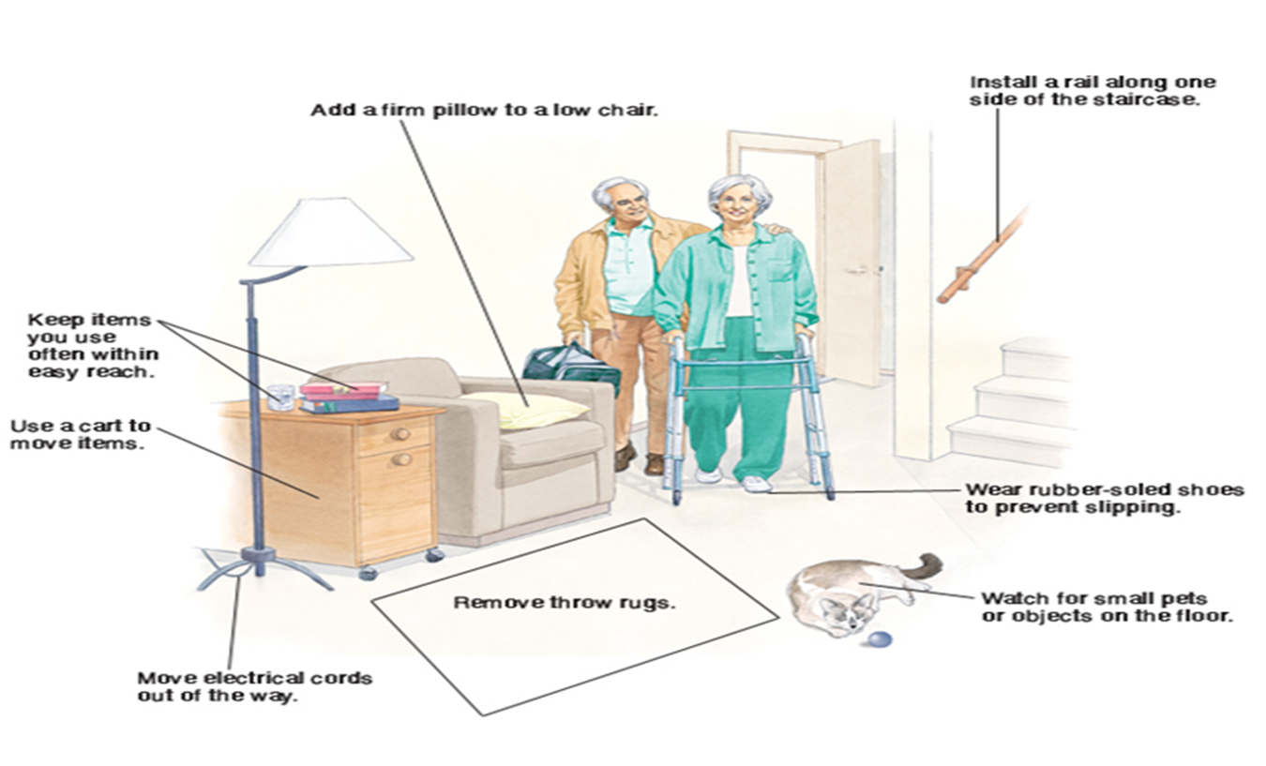
Home Safety Check

Slide 12

Smoking and Surgery
Quit smoking to avoid the following
  Reduced blood supply to bones, muscles, joints, and other tissues in the body.
  Slows bone healing, the risk of bone not healing is almost 4 times greater among smokers than nonsmokers.
  Increased risk of surgical site infections, smokers are more than double those of nonsmokers.
  Increased risk of heart and lung complications during surgery.
  Increased risk of being admitted to an intensive care unit (ICU) after surgery.
  Increased risk of remaining in hospital longer after surgery.
  Increased risk of readmission into the hospital after surgery.
  Increased risk of dying in hospital.

Slide 13


Preadmission Testing
About a week before surgery, you will need to have blood work and other tests done. These tests help your doctor look for health problems that need to be addressed before your surgery. Your surgeon’s office will schedule this appointment for you. The preadmission testing usually takes between 2 to 3 hours.
  Please bring the following information to your appointment:
  Picture identification (such as a driver’s license)
  Your insurance card
  A complete list with all your medications
  Copies of any recent medical tests you may have had done
  Copy of your living will or power of attorney (if you have them)

Slide 14

Day Before Surgery
Eat a light dinner.
Nothing to eat or drink after midnight.
Download and setup the EASE app, if desired
Change the sheets on your bed so that you will have clean sheets when you come home.
Wash with CHG provided at pre-testing as instructed.
Only take medications that have been approved by your surgeon with sips of water.

Slide 15
What to Bring to the Hospital
Glasses, dentures, and hearing aides if needed.
Hygiene items if preferred. (Toothbrush, toothpaste, deodorant)
Comfortable non-skid shoes
Comfortable, loose fitting clothes.
Back/neck brace (if ordered by your surgeon)
Please do not bring any money, credit cards, jewelry, or other valuables to the hospital.

Slide 16
Your Hospital Stay

Slide 17
Day of Surgery
Check in at the reception area in the hospital.
You will be taken to the pre-operative area where you will be seen by an anesthesiologist.
You will have an IV (intravenous line) started at this time.
You will be given medication to help you relax and then you will be taken to the operating room for your surgery.
Your loved ones will be taken to the waiting room and will receive updates through the EASE app as you progress, if you use it.
When your surgery is done, the surgeon will inform your loved ones about how the surgery went and your status.

Slide 18
Recovery Room
You will wake up in the recovery room and most likely spend a couple of hours there.
When you wake up you may have:
  a small tube delivering oxygen into your nose
  a clip or tape attached to your finger with a red light that records your oxygen level and pulse
  Sleeves wrapped around your legs that fill with air gently squeezing your legs starting at your ankles then going to your calves. These help prevent blood clots.
  A catheter coming from your bladder that drains urine into a bag
  A dressing on your back or neck
  You may have a drainage tube coming from near the incision area attached to a suction device.

Slide 19
Nursing Unit
Once stable, you will be taken to your hospital room. Your nurse will greet you and make sure that your needs are met. They will show you how to use your phone, the TV remote, and how to call for assistance.
Your nurse will make sure you are as comfortable as possible. It is very important that you tell the nurse about pain or any other problems so they can help you become more comfortable.
Common side effects of anesthesia and narcotic pain medications include nausea, vomiting, lightheaded feeling, low blood pressure, and possibly headache.
Ask your nurse before getting out of bed, so they can assist you and make sure that you are safe.
CALL, DON’T FALL!

Slide 20
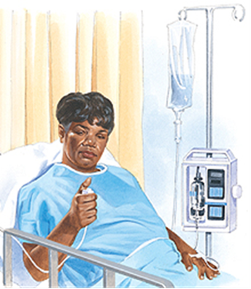
Pain Management
Orlando Health uses 0–10 rating scale to measure pain. No pain is “0.” A “10” means that you have the worst possible pain. Your nurse will ask you for your pain goal. This number represents the pain level at which you will be able to comfortably get out of bed and do physical therapy.
If a PCA (patient-controlled analgesia) is ordered for you, be aware that only you, the patient, are allowed to press the button for medication. If this does not reduce your pain, let your nurse know.

Slide 21
Pain Management (continued)
You should expect to experience some pain after the surgery. The chronic pain you were experiencing before the surgery should be improved, but now we have to help you manage your surgical pain, which will improve with time.
Please follow these guidelines to have a better pain management experience:
  Communicate to your nurse your pain experience. This will help the nurse understand your pain management needs better.
  Don’t wait until your pain is unbearable, let the nurse know that you are having pain.
  Change positions frequently, this helps reduce pain from stiffness.
  Participate in your physical therapy. Working with the therapy team can reduce spasms and soreness.
  Use cold therapy as instructed.
  Get out of bed with help and be as active as possible.

Slide 22
After Surgery Plan

Slide 23
After Surgery: Day 0
Arrival to your room and walk from stretcher to bed, if able. Up to restroom and possibly chair, with nursing staff as needed.
Vital signs, pain control, and begin breathing exercises.
Up and out of bed walking frequently (If possible).
Clear liquid diet as tolerated, advance to soft diet if possible.
Possible visit from Physical or Occupational Therapy for evaluation
Your nurse will show you how to use the incentive spirometer. This helps prevent pneumonia and reduce fatigue. Try to use this 10 times each hour while you are awake.

Slide 24
After Surgery: Day 1
Advance Diet
Continue pain control and breathing exercises.
Up and out of bed walking frequently, working with one of our therapists if ordered.
If a urinary catheter, drain, or pain pump is in place these may be removed today.
If ordered a Care Coordinator will visit you and help you start planning for discharge.
Depending on the type of surgery and how you have progressed, you may be going home today.

Slide 25
After Surgery: Day 2
Physical therapy and/or occupational therapy will continue to see you
If you still have a catheter, it will be taken out today
You will be doing increased amounts of activity, primarily walking
If you have a drain, it may also be taken out
Your dressing may be changed
Our goal is to discharge you home today by noon

Slide 26
Discharge Home
All surgery has a risk of side effects that you should monitor for as you go home
  Constipation can be a side effect of anesthesia and the pain medications you will be taking. Increased water intake, increased mobility, and the addition of a stool softener should help keep things moving.
  Sore throat and some difficulty swallowing are very common side effects of the anterior neck surgeries but can occur with any surgery. Progress to solid foods slowly and use throat lozenges to reduce discomfort.
  Pain is an unavoidable side effect of all surgeries. Proper use of pain medication, cold therapy, and frequent mobility will help keep your pain level manageable.
  Stress and anxiety are frequently felt by patients both before and after surgery. Having realistic goals and keeping a positive outlook can help keep these manageable. The hospital also has a team of patient/family counselors and spiritual care representatives to help you cope with these feelings.

Slide 27
Discharge Home (Continued)
Incision Care and Hygiene
  Watch for redness, swelling, and drainage from your incision. Make sure you are changing your dressing per your surgeon's instructions.
  If you have steri-strips (small surgical tapes), do not remove them, they will begin to fall off on their own. You do not need to replace them.
  If you are sent home with a drain still in place, we will teach you how to maintain it until your follow up.
  If you have stitches or staples, they will be removed by your surgeon when you follow up in 10 – 14 days.
  Do not take a bath, swim or in any way submerge your incision site until cleared by your surgeon.
  Items like walkers and/or shower chairs should be used, if necessary, to safely shower once your surgeon has cleared you to shower.

Slide 28
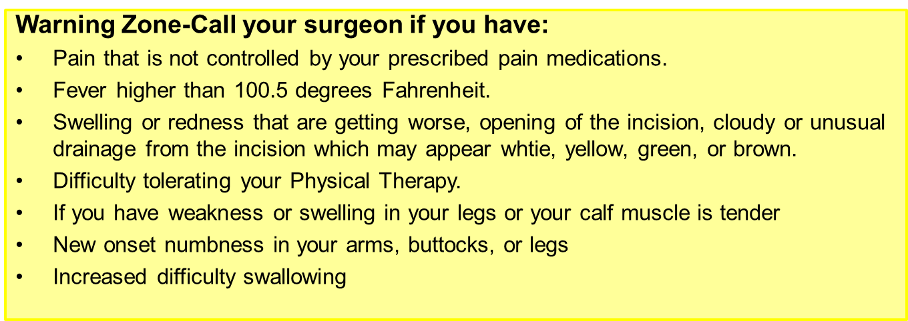
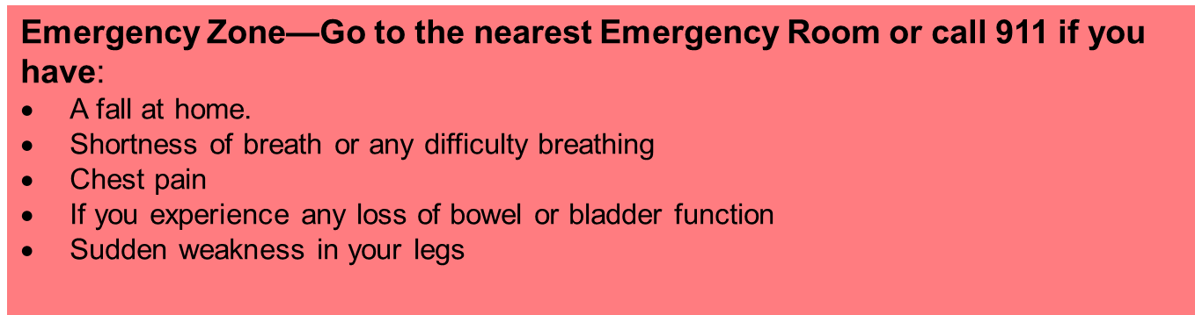

Slide 29
Therapy and Getting Moving

Slide 30
Physical Therapy
Physical Therapy may see you during your hospital stay to evaluate you for safety and to educate you about your precautions.
Physical Therapy will begin teaching you how to safely progress with movement after surgery.
They will also begin working with you on exercises you may do to jump start your recovery and strengthening advancement.

Slide 31
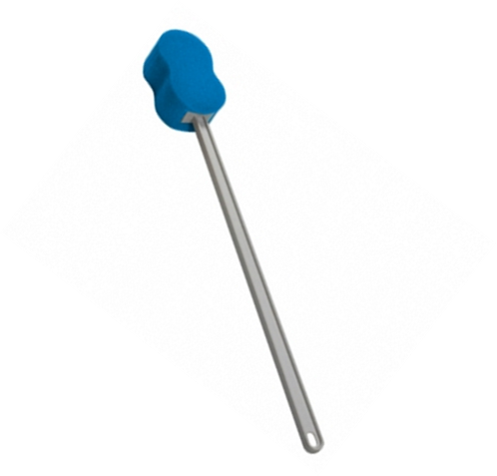


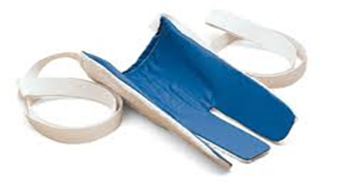
Occupational Therapy
Occupational Therapy may see you during your hospital stay to teach you how to perform activities of daily living such as putting on your pants and socks while maintaining your precautions.
You may wish to purchase adaptive equipment prior to surgery and bring to the hospital to use with your OT.
  Sock aid
  Reacher
  Long handled sponge
  Leg lifter

Slide 32
Activity
Being active after surgery is the most important thing you can do to prevent complications. Your Physical Therapist(PT), Occupational Therapist(OT), or your nurse will review your spinal precautions with you and help you to get out of bed into the chair and walk several times a day. You will find that you can do more and more each day.
Benefits of mobility include:
  Reduced risk of blood clots
  Reduced surgical pain
  Reduced chance of pneumonia
  Reduced chance of constipation

Slide 33
Precautions
A good way to remember your spinal precautions is “NO BLT.” This means no Bending, Lifting or Twisting.
To aid your recovery, please follow these simple rules:
  Do not lift more than 5 pounds.
  Do not push or pull things.
  Use the logroll technique to get in and out of bed.
  Frequent walking is good for your recovery.
  Get up every 30 minutes or so to walk around before returning to your chair.
  Do not stay in bed all day. If you are not active, you may be at a higher risk of developing a blood clot and other complications.

Slide 34
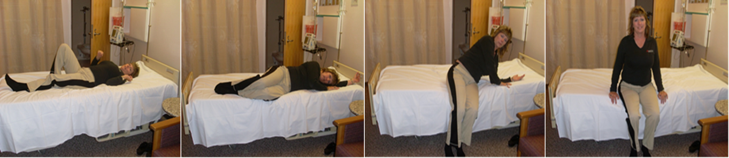
Transfers
Log Roll Technique: When getting out of bed, roll onto your side, drop your legs over the edge of the bed and use your arms to push your upper body into a sitting position.
Use the same method regardless of which side of the bed you get up from.

Slide 35
Transfers (Continued)
Chair Transfer: When getting into a chair, preferably one with arm rests:
  back up until you feel the back of your legs touch the chair.
  Reach back for the armrest without twisting. Gently lower yourself onto the chair.
  To stand, push up using the armrest, keeping your weight on your legs and arms.
  If necessary, the same procedure can be used for transfers to a 3-in-1 commode or into and out of a vehicle.

Slide 36
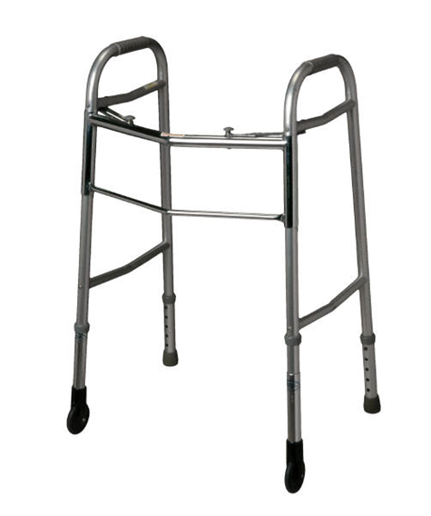
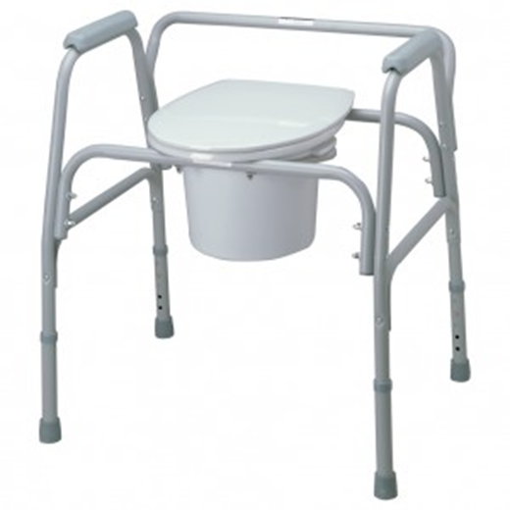
Equipment

Slide 37
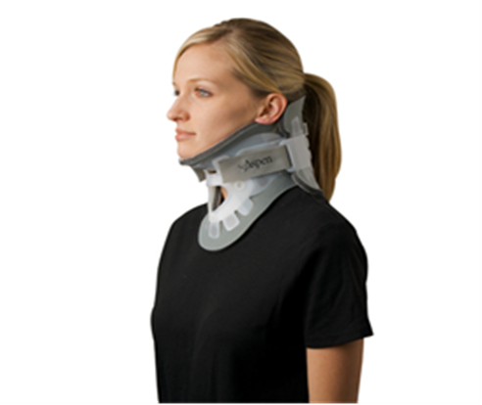
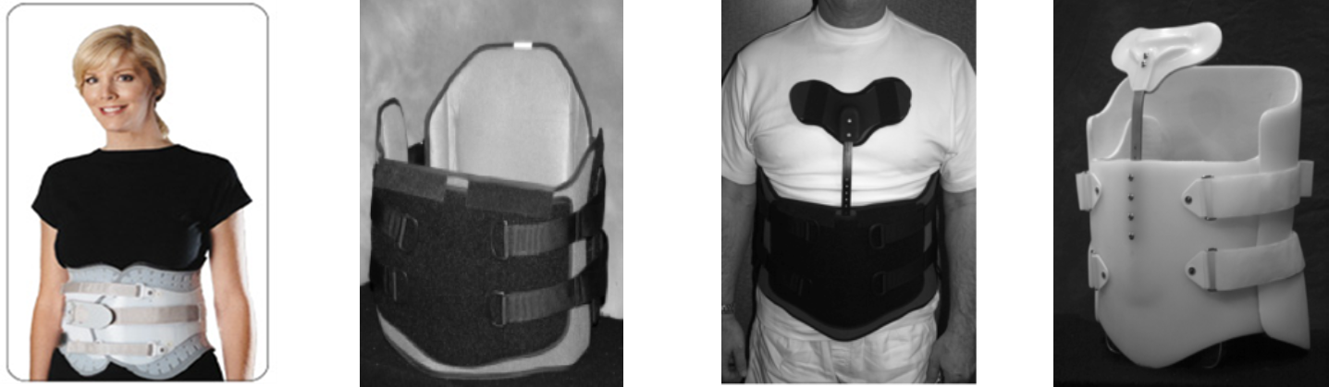
Equipment (Continued)
Neck and back braces

Slide 38

Thank You!
From the Best Hospital Possible
Use the below link or QR code to complete your post test!
https://forms.office.com/Pages/ResponsePage.aspx?id=2IGqoZd4C0Gish0ZACS3-FJlfq1ekSdJgiM562ClGVZUMTBXTkRUV1lIUDU1T1gxWE9KV1hWMkcwMC4u

Slide 39
Resources
https://www.mayoclinic.org/diseases-conditions/herniated-disk/multimedia/diskectomy/img-20008514
https://www.mayoclinic.org/tests-procedures/laminectomy/multimedia/laminectomy/img-20006364
American Academy of Orthopaedic Surgeons (AAOS)
aaos.org
American Association of Neurological Surgeons (AANS)
aans.org
National Association of Orthopaedic Nurses
orthonurse.org
American Chronic Pain Association (ACPA)
916.632.0922 or 800.533.3231
theacpa.org
National Foundation for the Treatment of Pain
713.862.9332
paincare.org
American Pain Foundation
888.615.PAIN (888.615.7246)
painfoundation.org

